Slide 1
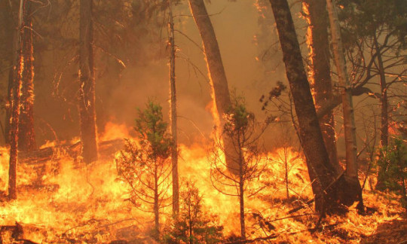
Emergency Evacuation
Action Planning
Burland Firewise

Slide 2
WELCOME / OVERVIEW
Emergency Evacuation Action Planning
CodeRed
Contacts – Personal & Business Phone Numbers
Evacuation Routes
Shelter in Place
Emergency Temporary Areas of Refuge
Pets & Livestock

Slide 3
WELCOME / OVERVIEW continued
Where to Go
Stuff to Take
Emergency Supply Kit
Red Flag Weather
House Preparation
Information Sources
Reflective Address Marker

Slide 4
CODERED
What is CodeRed? Notification System versus Phone App.
Public Emergency Notification System
In an effort to reach more citizens during an emergency, Park County uses the CodeRED Emergency Notification System.
Park County residents are able to enter their own data and choose how they would like to receive the notification. Phone, text, email. Any combination of the three.

Slide 5
CODE RED
How do I sign up for CodeRed?
Fill out the CodeRED Residential Data Collection Form online from the CodeRED website: parkco.us/97/codered
Your information immediately updates Park County’s CodeRED telephone number database.
Don’t have access to the internet? Fill out a paper form that will be available at local government offices.
Or call the Park County Communications Director at 719-836-4115.

Slide 6
CONTACTS / PHONE NUMBERS
John Doe 303/929-3098 C
Jane Doe 303/929-7047 C
Betsy 720/344-3455 C
Pete 720/301-7542 C
Bryan 720/273-9518 C
Josie 406/223-1991 H
Grandma 209/722-1715
Let family members and close friends know you are safe.

Slide 7
BUSINESS PHONE NUMBERS
Insurance Company
Agent – Joie Bowie 720/344-Y6942457
Policy Number # Y6942457
AAA Colorado 303/929-Y6942457
Roadside Asst. 800/222-Y6942457
IREA 303/838-Y6942457
Gas Company 303/838-Y6942457

Slide 8
EVACUATION ROUTES
Dependent upon:
Where your home is located.
Where the fire is coming from.
CR72 to Crow Hill/Hwy 285.
CR72 to Sleepy Hollow/Rosalie to Hwy 285.
CR72 to Kudu Trail to Impala Trail to Meadow Drive
to Roland Valley Drive to Hwy 285.

Slide 10
SHELTER IN PLACE
If evacuation routes are blocked, SHELTER IN PLACE.
What is Shelter in place? Take Shelter wherever you happen to be, in your home, in your vehicle.
Wear long pants and long sleeves (natural fibers),
Wear close toed shoes.
Stay hydrated.
Consider purchasing a backup generator for well pump.

Slide 11
SHELTER IN PLACE continued
Fill sinks and tubs for emergency water supply.
Prepare to place wet towels under doors to keep
smoke out.
Stay away from outside walls.
Ensure you can exit if the home catches fire.
After the fire passes, check the roof / trap points, extinguishing all embers in Zone 1 (0 - 5 ft).

Slide 12
EMERGENCY TEMPORARY AREA OF REFUGE
What is an Emergency Temporary Area of Refuge?
Designated areas that are wildfire defensible / survivable.
For “short term” use when evacuation routes are closed and your home is threatened preventing you from sheltering in place.

Slide 13
EMERGENCY TEMPORARY AREA OF REFUGE
continued
If the home is threatened shelter in an AREA OF REFUGE.
Burland Ballfields / Burland Equestrian Area.
Burland Recreational Ponds.
Disk Golf Park (School Land)
Weakland Fawks Park
Hi Meadow Burn area.
Additional Areas of Refuge are being considered.

Slide 15
PETS / SMALL LIVESTOCK
Kennels, cages, beds, leashes.
Food, water, treats (Several days worth).
Bowls - food and water.
Medications.
Toys.

Slide 16
LARGE LIVESTOCK
Tack: halters, leads
Feed (Several days worth)
Buckets, troughs
Medications.
Boarding Sources:
JEFCO Fairgrounds
Fairplay Fairgrounds
Burland Equestrian Area (No water available)

Slide 17
Animal EVAC Volunteers
Front Range non-profit organization.
Need help evacuating your animals in an emergency call:
Park County - Animal Control 719-836-4122
Jefferson County - Animal Control 303-271-5070
AEV website: htts:www.animalevac.org/

Slide 18
WHERE TO GO
Assuming AMPLE TIME and LITTLE TRAFFIC and WE (ie A COUPLE / A FAMILY) ARE TOGETHER.
With multiple vehicles, head north to family/friends/hotel via Highway 285.
If north bound Hwy 285 is blocked, head south to family/friends/hotel via Fairplay.
DON’T WAIT, PREPLAN WHERE TO SAFELY GO!

Slide 19
WHERE TO GO continued
Assuming LIMITED TIME and HEAVY TRAFFIC and WE (ie A COUPLE / A FAMILY) are TOGETHER.
With one vehicle, head north to family/friends/hotel via Highway 285
If northbound Hwy 285 is blocked head south to family/friends/hotel via Fairplay
DON’T WAIT, PREPLAN WHERE TO SAFELY GO!

Slide 20
WHERE TO GO Continued
Assuming LIMITED TIME and HEAVY TRAFFIC and WE ARE NOT TOGETHER.
With one vehicle, head north to family/friends/hotel via Highway 285
If northbound Hwy 285 is blocked head south to family/friends/hotel via Fairplay
DON’T WAIT, PREPLAN WHERE TO SAFELY GO!

Slide 21
WHERE TO GO Continued
You work in the city and your child, a physically challenged dependent, an aging parent is home without transportation.
Do you have a plan?
Does your family know your plan?
Get to know your neighbors!
DON’T WAIT, PREPLAN WHERE TO SAFELY GO!

Slide 22
WHAT TO TAKE
EMERGENCY SUPPLY LIST
Assemble Long Before a Wildfire Occurs
3 day
supply
,

Slide 23
STUFF TO TAKE (If time allows)
Bugout bags. What is this?
A change of clothes, sleep wear, personal items,
your pillow, items that make you comfortable.
Important documents - Pass port, social security number, will, power of attorney, etc.
Miscellaneous – Cash, check book, expense log, password cheat-sheet, address book, weapons, ammo, etc.

Slide 24
STUFF TO TAKE (If time allows) continued
Electronics’ – Cell phones, lap tops, tablets and
charging cables.
Medications
Video of home, furnishings and contents
Share video with your insurance agent via a flash drive.
DON’T WAIT, DO IT NOW!

Slide 25
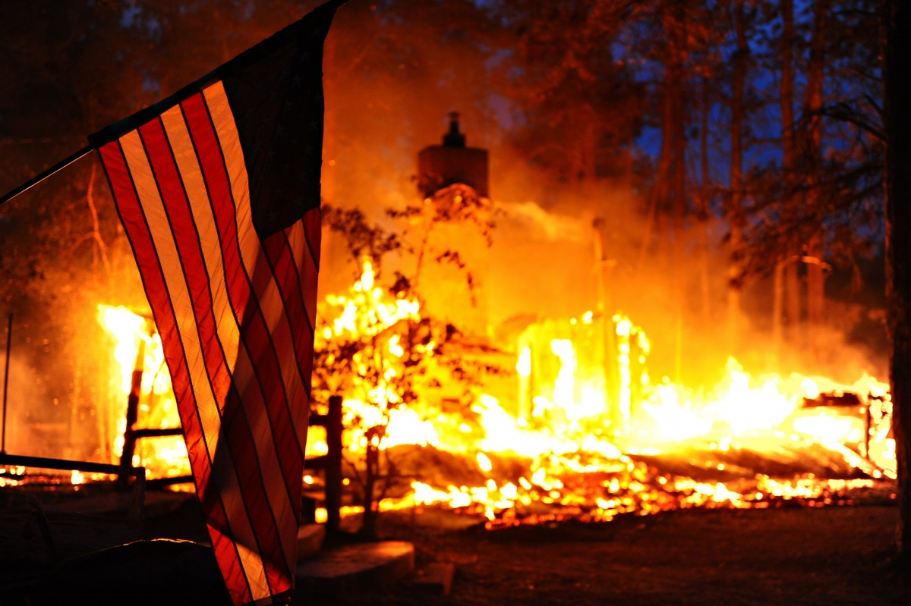
GO !
Leave Early !
Give your family
the Best Chance
to
Survive a Wildfire

Slide 26
EMERGENCY SUPPLY KIT
Clear plastic container
Hard copy of Emergency Evacuation Action Plan
First Aid Kit
Face Masks (N95 or N100)
Toilet Paper and Wipes

Slide 27
EMERGENCY SUPPLY KIT continued
Bottled Water
Flash light & batteries
Generic Meds (Advil, Tylenol, Allergy)
Important documents on a flash drive

Slide 28
RED FLAG WEATHER – High Fire Danger
Bring highly flammable deck items inside.
Stow BBQ propane and door mats.
Ensure flammable materials have not accumulated near the house or out buildings.
Prepare kennels, food, bowls, meds.
Bugout bags placed in your vehicle.

Slide 29
RED FLAG WEATHER continued
Gather Meds.
Prepare important documents to go in your vehicle.
Ensure vehicle gas tanks are full.
Prep ATV to go in garage.

Slide 30
HOUSE PREPARATION (IF TIME ALLOWS)
Close all windows and doors, leaving doors unlocked.
Why? A firefighter may need to shelter.
Remove window coverings (curtains, shades, blinds).
Why? Easily ignitable.
Turn on and leave on, interior and exterior lights.
Why? In thick smoke it may be visible to firefighters.

Slide 31
HOUSE PREPARATION (IF TIME ALLOWS) continued
Turn off gas - Furnace, fire place, and water heater.
Do you know where your shutoff valves are?
Turn off natural gas / propane to house.
Why? Turn off potential sources for an explosion.
When the electricity goes out, do you know how to open the overhead garage door?
Practice manually opening the overhead garage door.

Slide 32
HOUSE PREPARATION (IF TIME ALLOWS) continued
Notice posted near inside primary entrance:
HOME IS EVACUATED
Why? Time Saver for firefighters and law
enforcement ensuring home has been evacuated.

Slide 33
INFORMATION SOURCES
National Incident Information https://inciweb.nwcg.gov/
Platte Canyon Fire Protection District Facebook Page
https://www.facebook.com/Platte-Canyon-Fire-Protection-District-217608044988988/

Slide 34
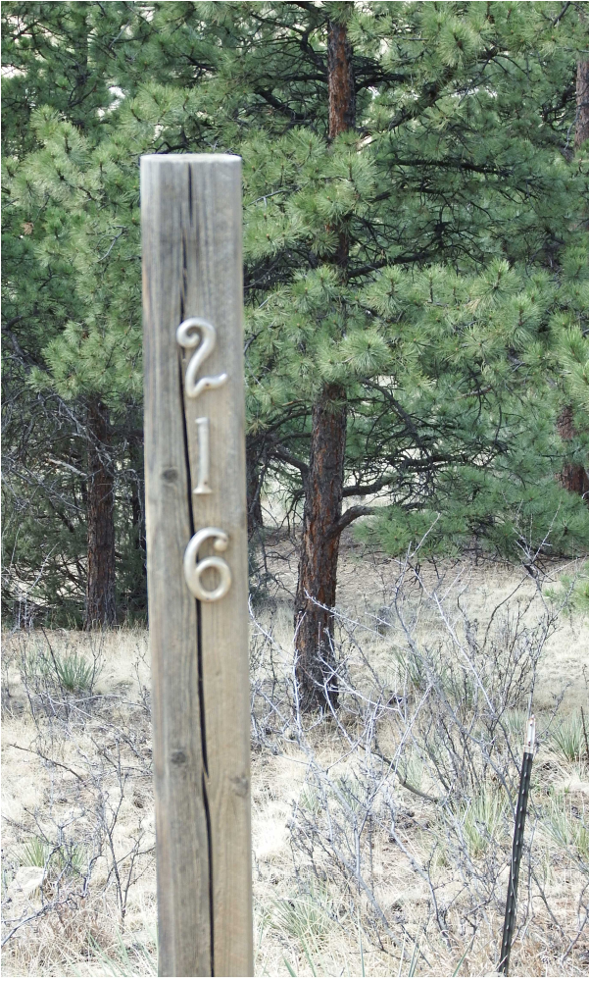
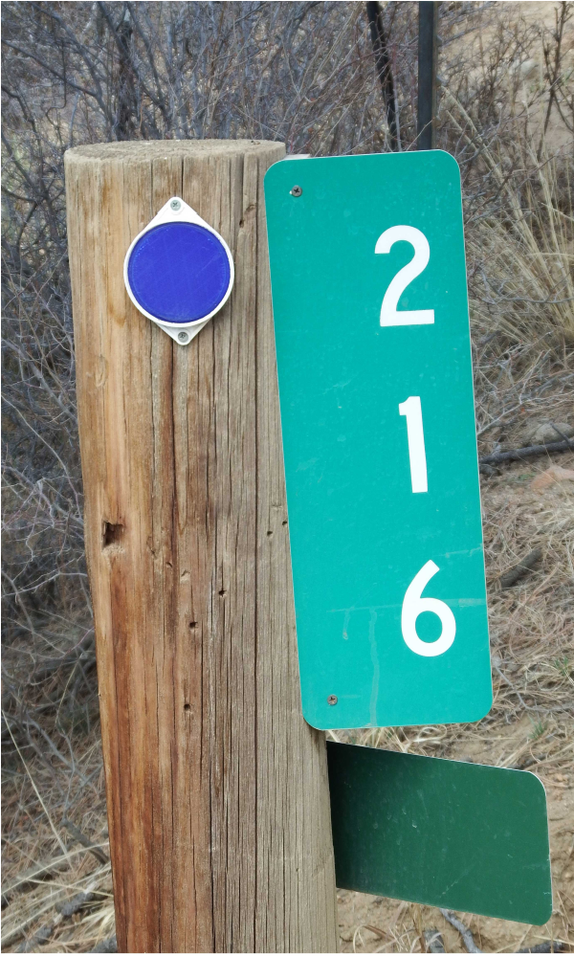
It’s 2 am on a rainy night
and your Family
NEEDS HELP.
Which address marker will get help there quicker?
Highly recommended by Platte Canyon Fire,
Ambulance Services and
Sheriff’s Department

Slide 35
Your Top Five Take Away’s
Sign up for CodeRed
Create an Emergency Evacuation Action Plan
Install a Green Reflective Address Marker
Nothing Flammable within 5 feet of your Home
Evacuate Early! Don’t wait to be told to leave.

Slide 36
BURLAND FIREWISE COMMITTEE
Burland Firewise Coordinator Bill Beggs
Committee Members
Tom Ingwalson Carrie Marsh
Charlotte Wytias Shelby Edwards
Mark Evert Ed Hayslett
Sue Glenn Howard Hansen
Roxanne Turnbull Susanne Barkley
Debra Stephen

Slide 37
BURLAND HOMEOWNERS ASSOCIATION
President Jeff Baker
Vice President TBD
Secretary William “Bill” Beggs
Treasurer Bill Bruner
Directors
Debra Stephen Keith Doubleday
Mike Fisher Jon Murillo

Slide 38
PLATTE CANYON FIRE PROTECTION DISTRICT
Fire Chief Ben Mulligan
Deputy Chief Jared Black
Physical Address Mailing Address
PCFPD Station #2 PCFPD Station #2 153 Delwood Drive P.O. Box 222 Bailey, Colorado 80421 Bailey, Colorado 80421
303/838-5853 303/838-5853

Slide 39
QUESTIONS?

Slide 40
Thank you for Attending
Emergency Evacuation
Action Planning
Burland Firewise

